Slide 1
Together:
We're serving communities here in New Zealand with over 34 projects in partnership with you - our churches.
Your support in 2020 enabled us to help thousands of kiwi families overcome hardship through providing meals, depression recovery support, youth mentoring programmes, amongst other projects.
We have helped 2,800 kiwi families!
2800 families served

Slide 2
Called to be the Light
"Let your light shine before others, that they may see your good deeds and glorify your Father in Heaven."
MATTHEW 5:16

Slide 3
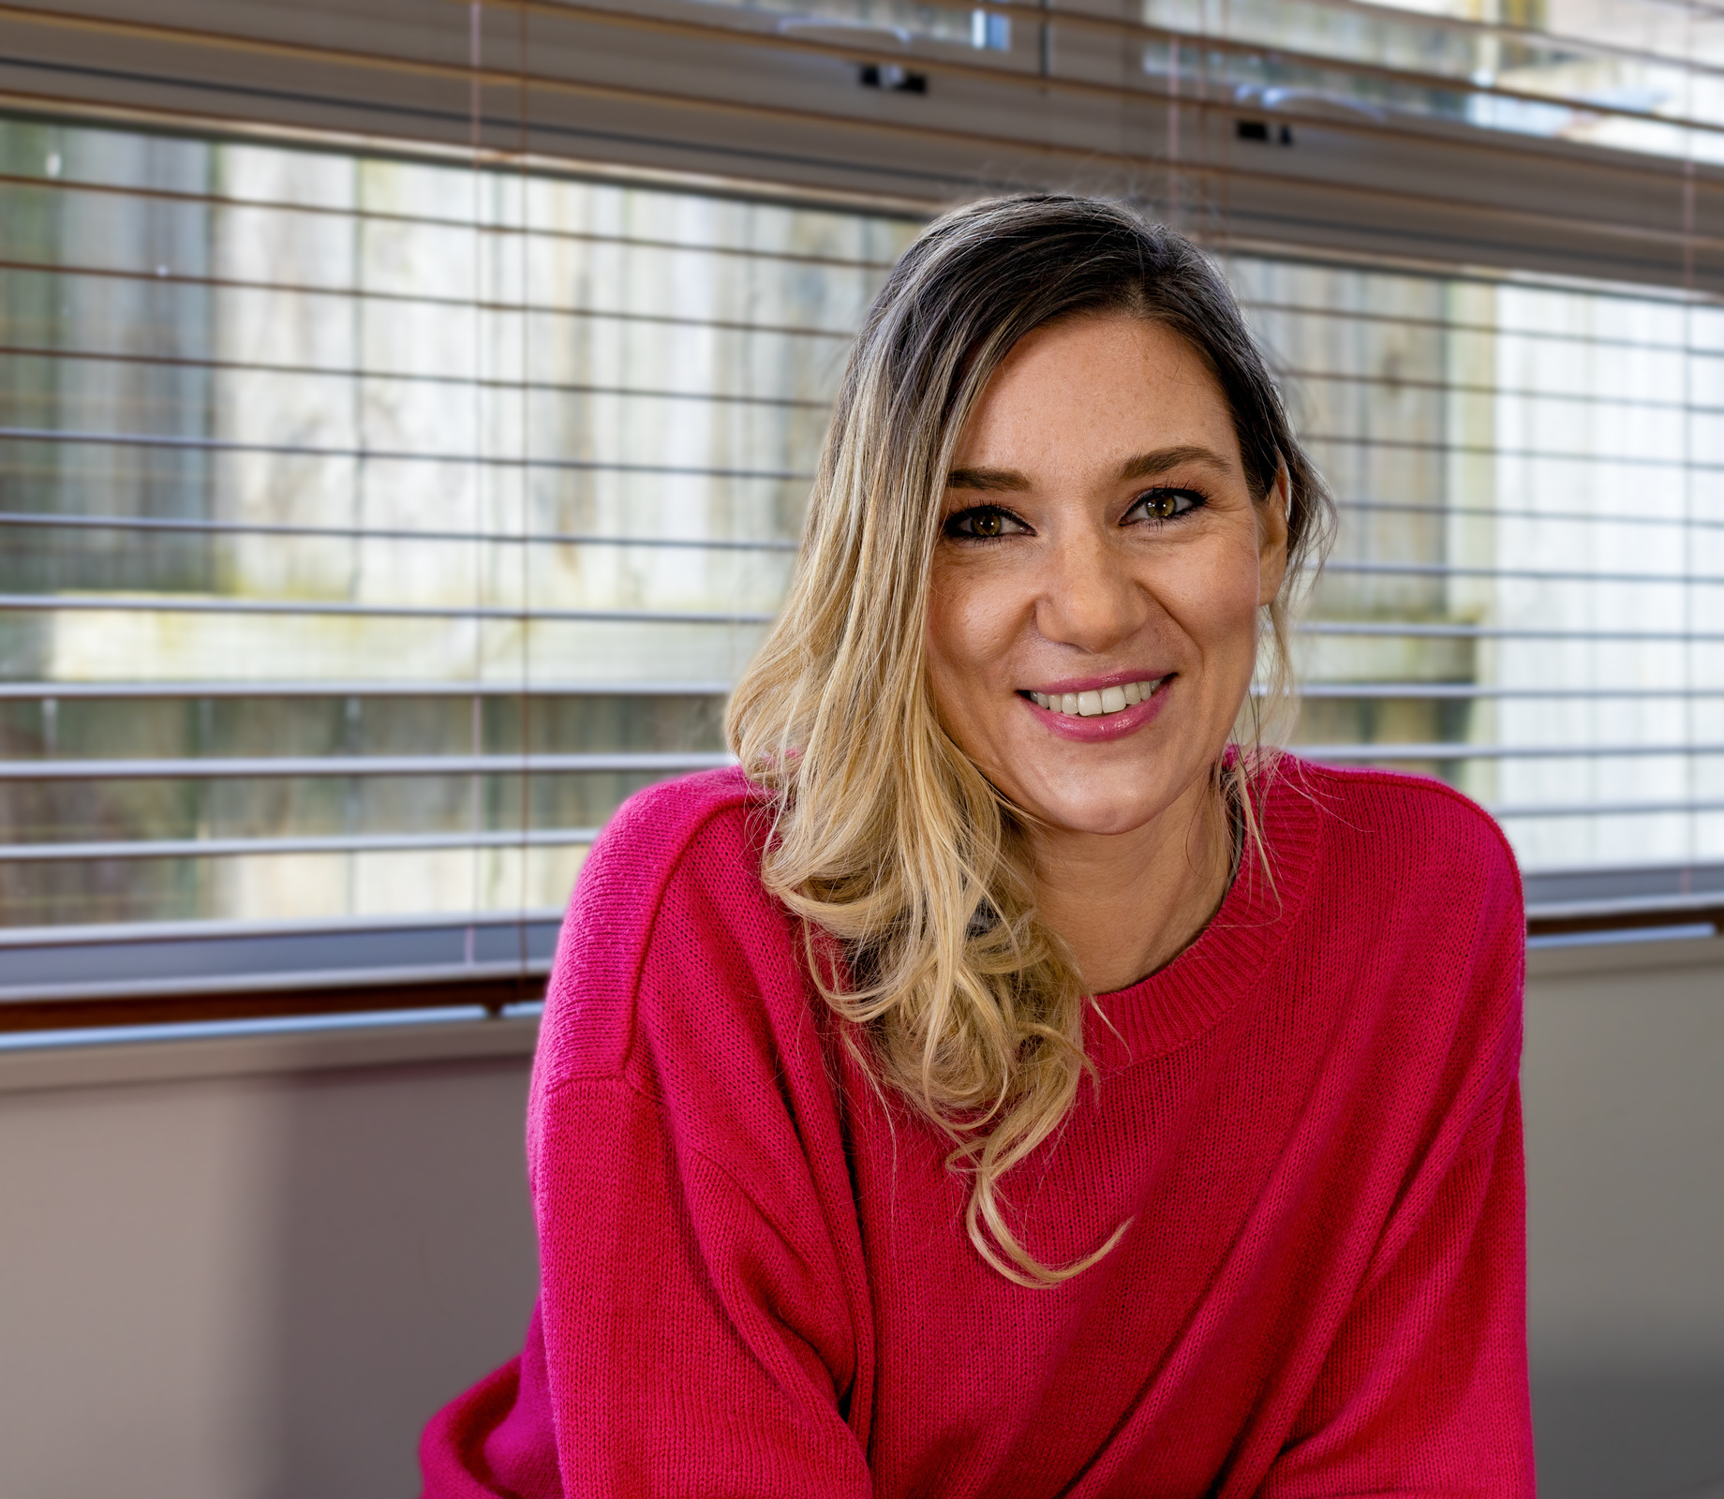
Your Offering
Will ensure together, we can Let Love Shine in our communities here in New Zealand and around the world.
Learn more about the difference we're making and support families facing hardship:
adra.org.nz/shine

