Slide 1

EQUIPPED TO:
Confidently Assess and
Design Your Initiative

Slide 2

Personal Assessment
Are we allowing God to lead the choice of community initiatives or we are making the decision?
Are we praying for the holy spirit to influence our thoughts and guide the process?
Are we aiming for some quick and easy programmes, or meaningful and long-term?
Are we being strategic, consistent & congruent in our work?
Are we willing to immerse ourselves in the community?

Slide 3

Listening Exercise
Pair up

Slide 4

How do churches decide what community initiatives to implement?

Slide 5
Is there a better way?
The best message to share is …
We don’t know how to help, but
We are willing to LISTEN
We would like to cooperate not to compete
We would like to complement not to complicate (duplicate)

Slide 6

Why community assessment?

Slide 7

“. . . until you see a city how people who are most in need of help see it, you’re never going to reach it.”

Slide 8
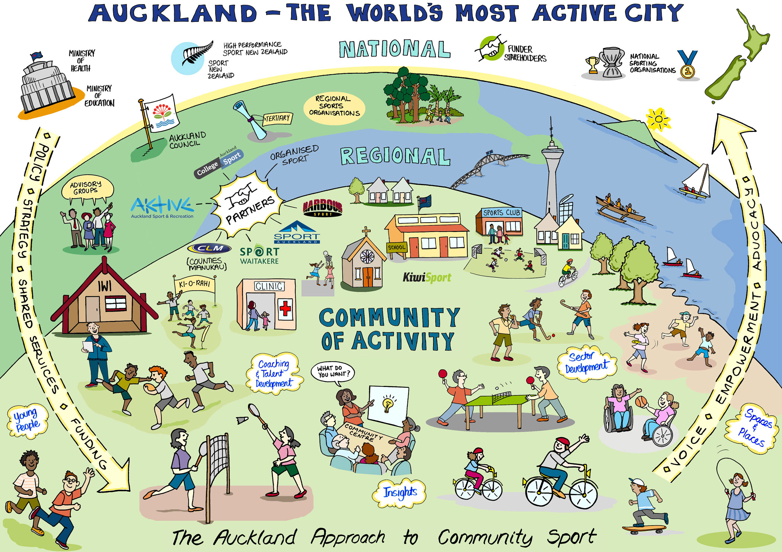
How are we going to see/understand it?

Slide 9
Community Assessment
To begin with:
Pray with your potential champions and church leaders for the holy spirit to influence your thoughts and guide you in the community assessment.

Slide 10

Community Assessment
Geographic area

Slide 11

Check Local Media

Slide 12
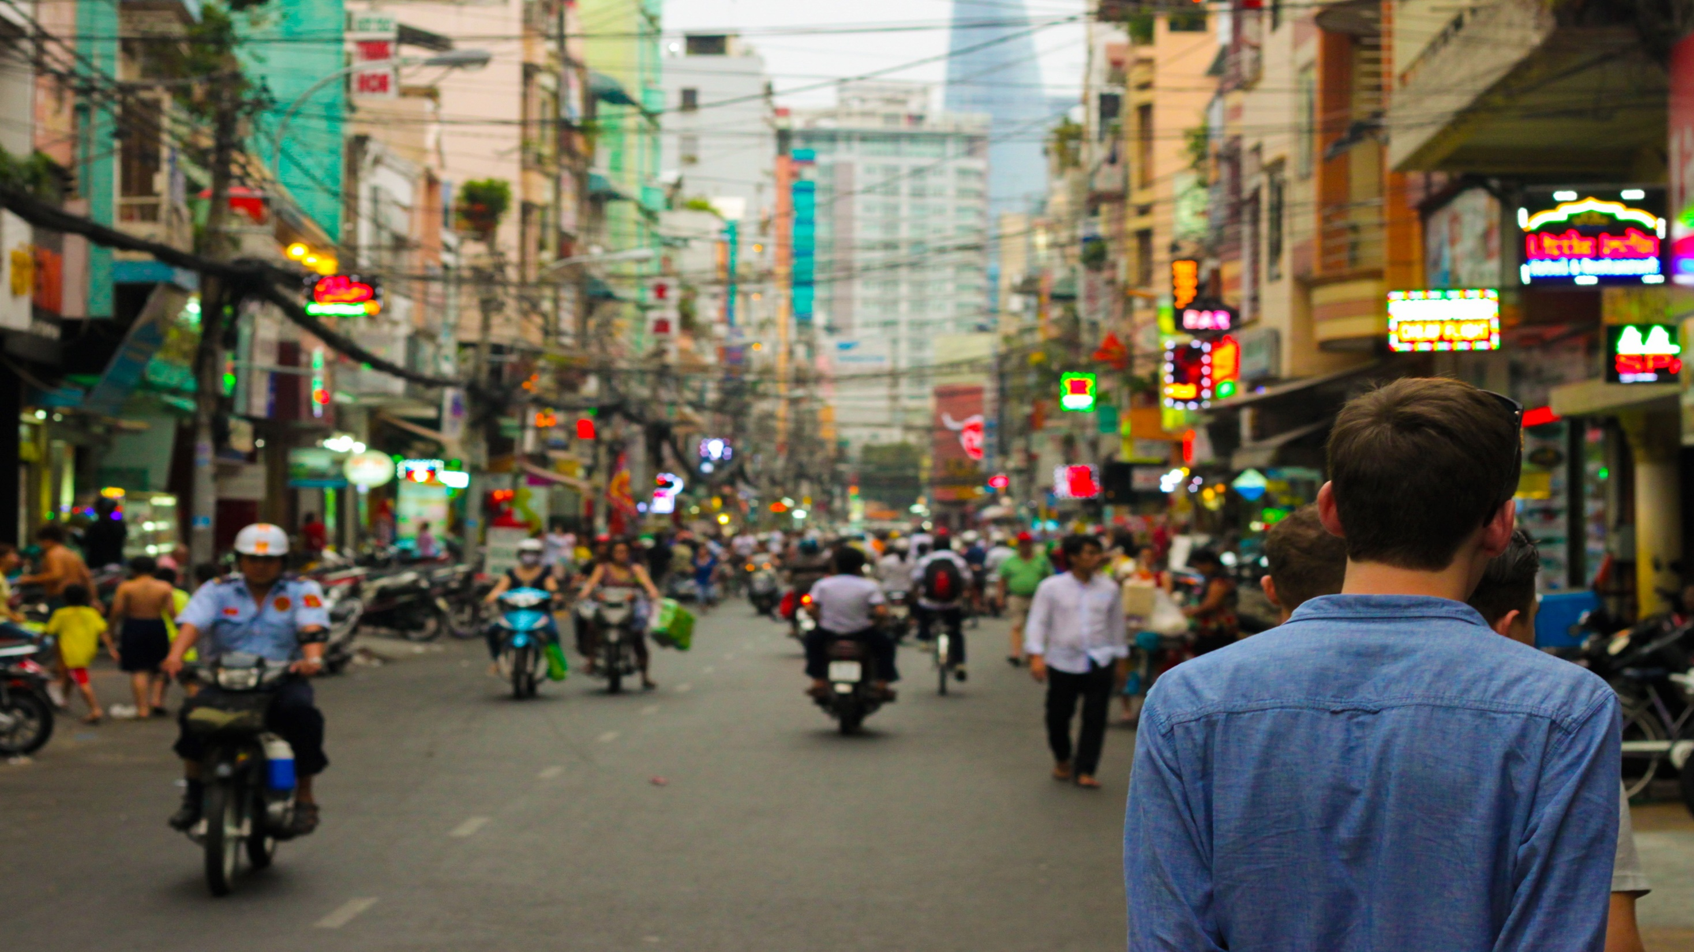
Walking Survey
1. Best in pairs.
2. Observe, sit, mingle.
3. Listen.
4. Write down your impressions.
5. Try to understand.

Slide 13

Conducting Interviews
Make appointment ahead of time.
Prepare brief list of questions
Explain the purpose of the interview.
Take notes.
Bring someone with you.

Slide 14
Is there a better way?
The best place to start is … ASK!
City Council
Community Agencies
Community Groups
Youth Groups

Slide 15
Is there a better way?
The best approach to have is …
City Council – Visit the Mayor
Community Agencies – Be a member
Community Groups – Belong to the groups
Youth Groups – Belong to the groups

Slide 16

Talk to local MP

Slide 17
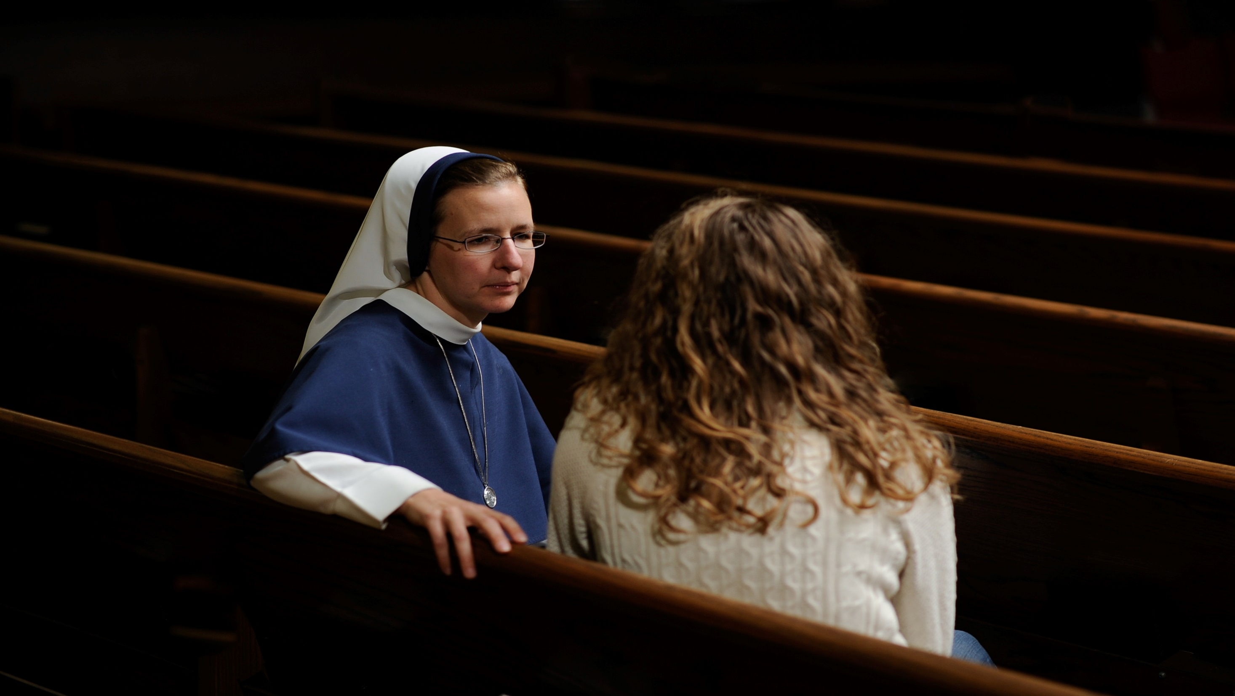
Talk to religious leaders

Slide 18

Talk to other service providers

Slide 19
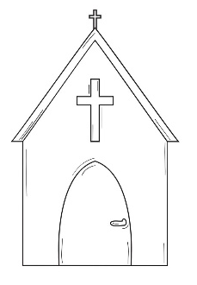

Mapping Exercise

Slide 20
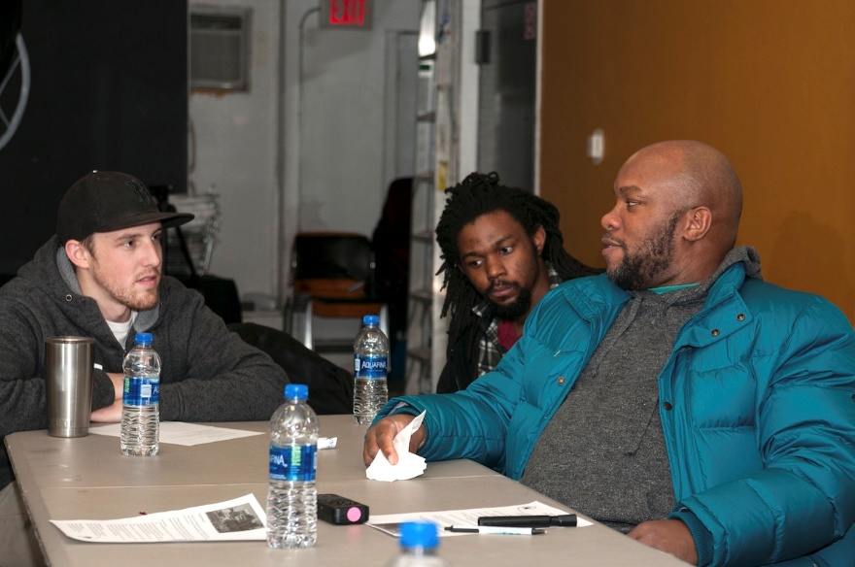
Interview church members to understand church capacity in terms of skills and available resources

Slide 21
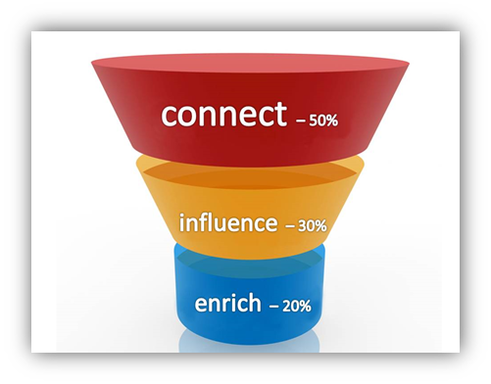
3 focuses
3 main focuses of a healthy church
Need to be spending time/resources proportionately
Deep and wide – growing members and reaching communities
Notes:
The three big circles represent your three main focuses in church ministry. For the three focuses to be successful they must be strategically placed in the shape of a funnel. Each of the focuses will take a different amount of your time, effort and attention. Your smallest circle – enrich – must be 20%, your larger circle – influence– must be 30%, and your largest circle – connect – must be 50%. Later I will explain why there is a precise distribution of percentages.

Slide 22

Where would you go?
How would you do it?

Slide 23
Practical Assessments
& Tools

Slide 24
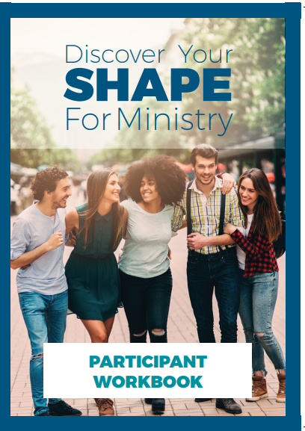
Design

Slide 25
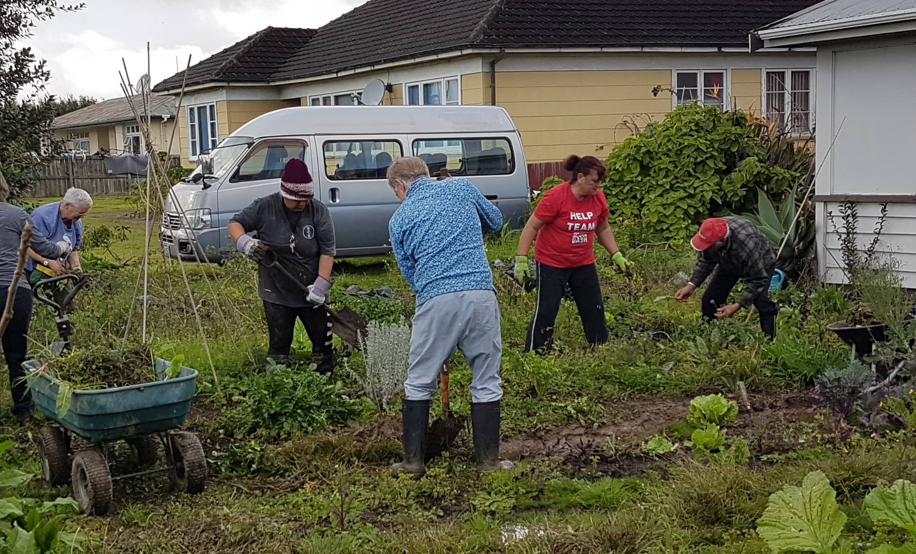
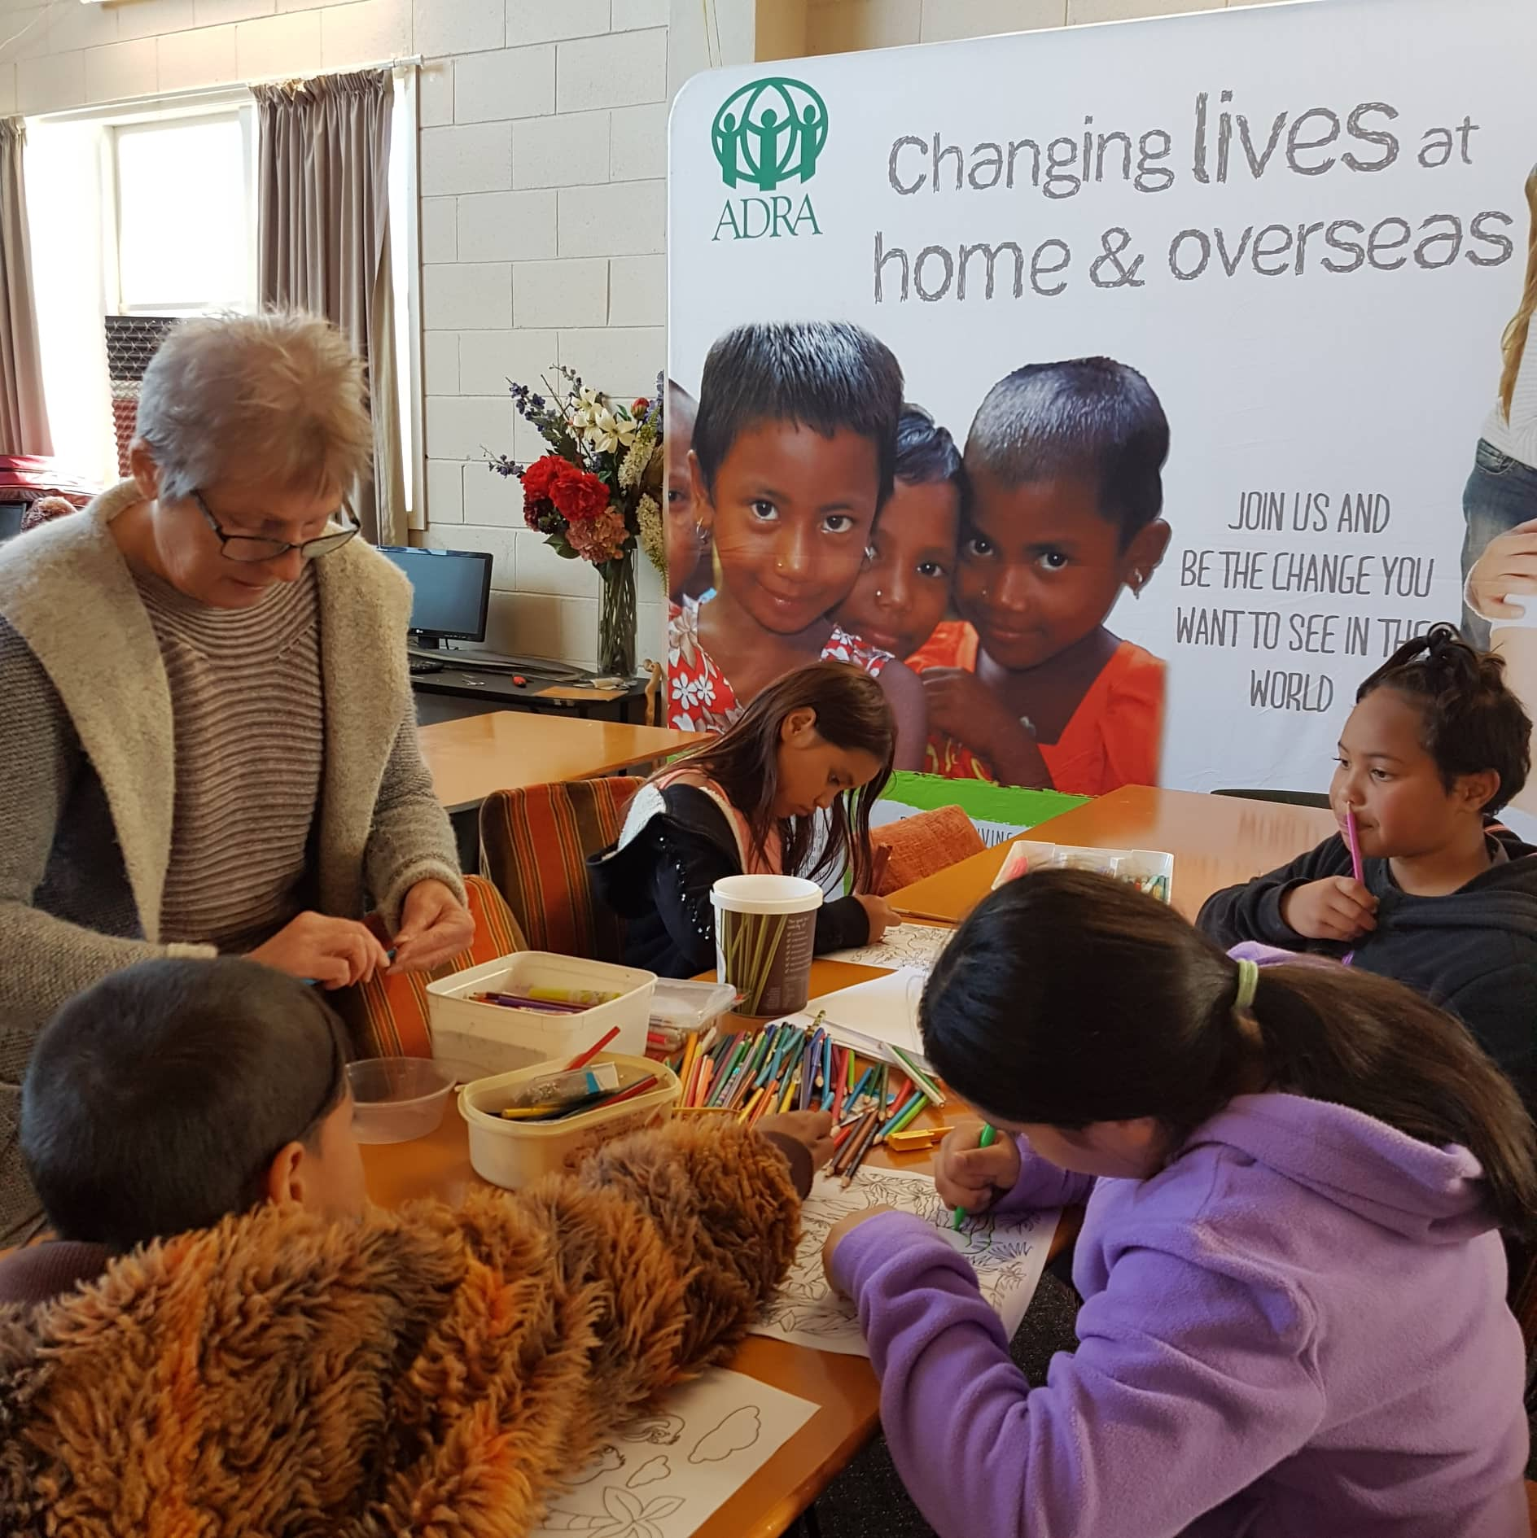
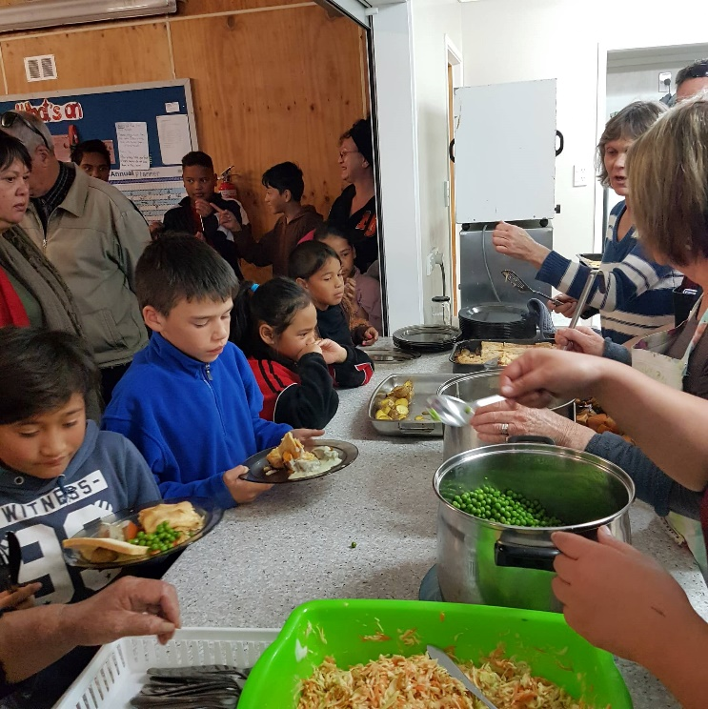
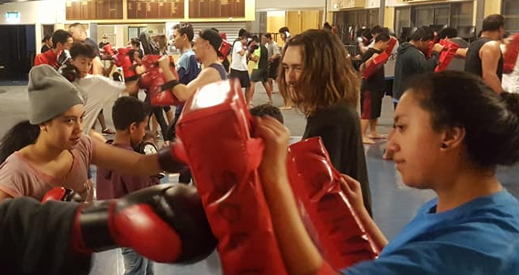
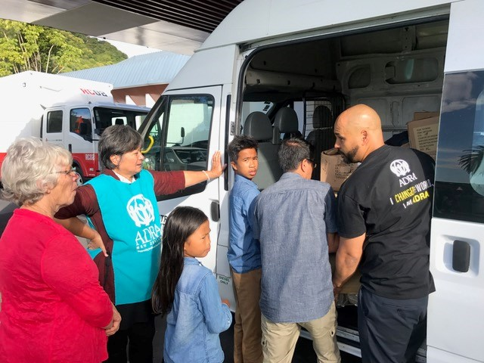
What is CTP?
Community Transformation Partnerships
Notes:
What is CTP?
- Who knows what CTP stands for? Community Transformation Partnerships

Slide 26


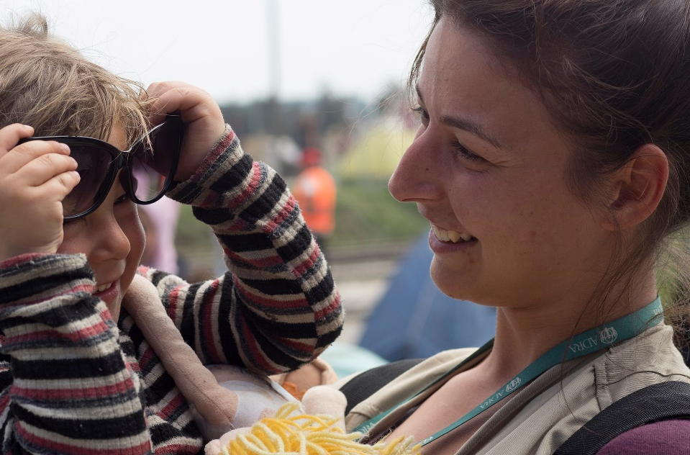

Empowering Local Churches to Transform their Communities
Notes:
Title Page Option 1

Slide 27
Why you need to be involved in your community?
My dear, dear friends, if God loved us like this, we certainly ought to love each other. No one has seen God, ever. But if we love one another, God dwells deeply within us, and his love becomes complete in us—perfect love!
- 1 John 4:11

Slide 28


Churches
CTP
Centre’s of Influence
Discipleship Path Model
Notes:
North New Zealand Healthy Communities as an example of strategies. Change this according to emphasis of the territory.

Slide 29
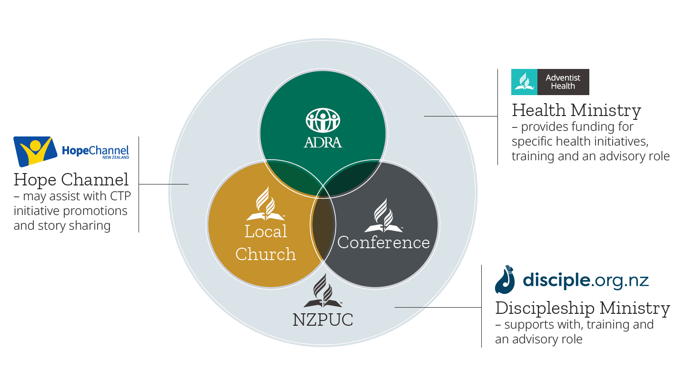
Partnership Model
Community Transformation Partnership (CTP)

Slide 30


Slide 31

Designing an Initiative

Slide 32




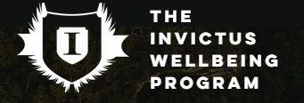
Community Transformation Partnerships

Slide 33


Community Transformation Partnerships
> My Family
  Pre-designed and resourced
  Shorter-term projects
  From $3,000
> Innovations
  Locally designed
  Longer-term programmes
  Min $5,000 up to $15,000

Slide 34
What’s your community involvement?
How many of you are doing something in the community, as a church, individual, part of a group?
Notes:
Discussion

Slide 35
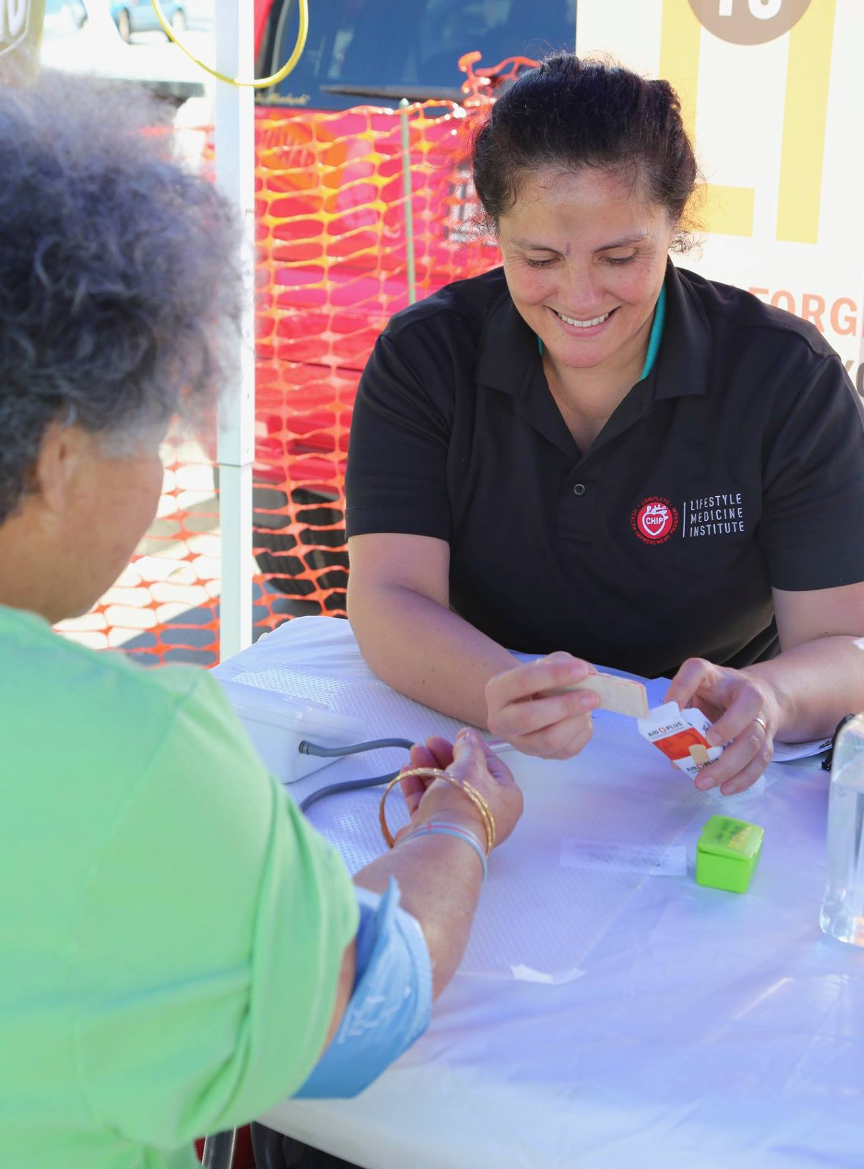
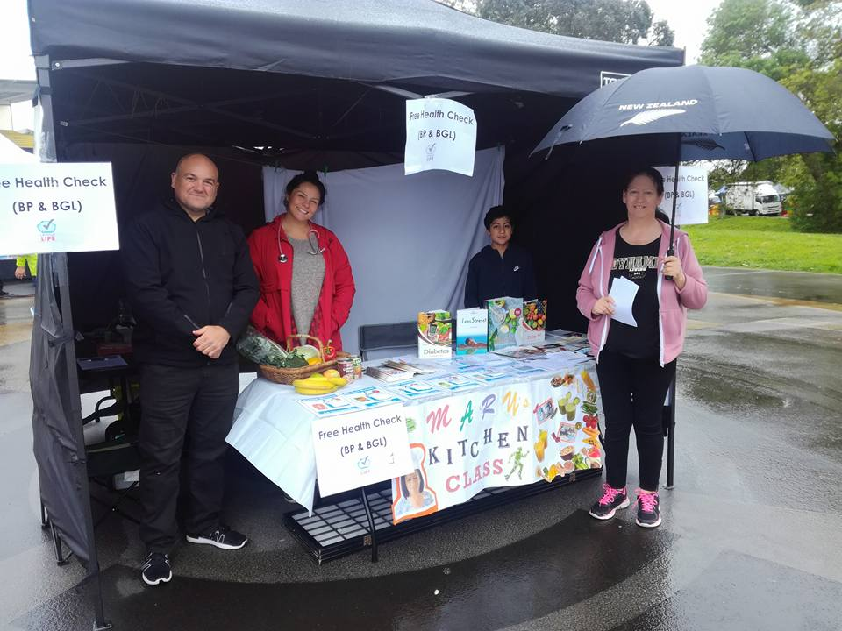
Health Assessments for the community

Slide 36


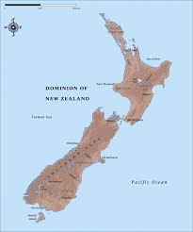
Collaborating with other Church ministries

Slide 37
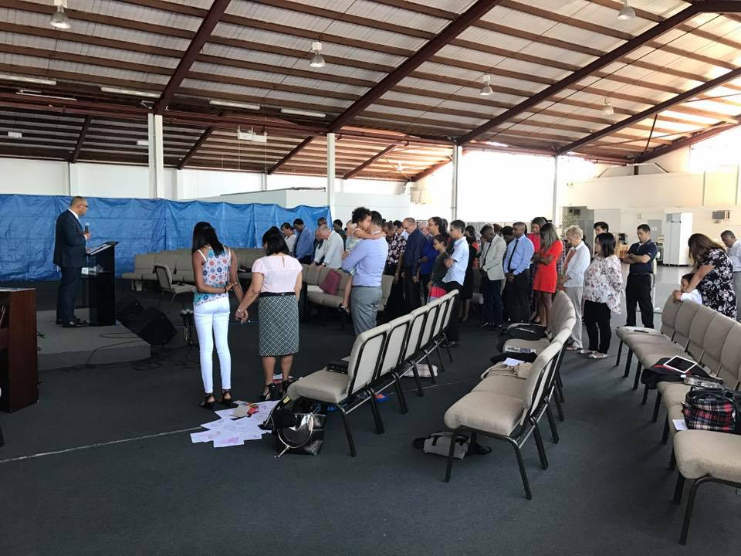
East Auckland City SDA Church

Slide 38
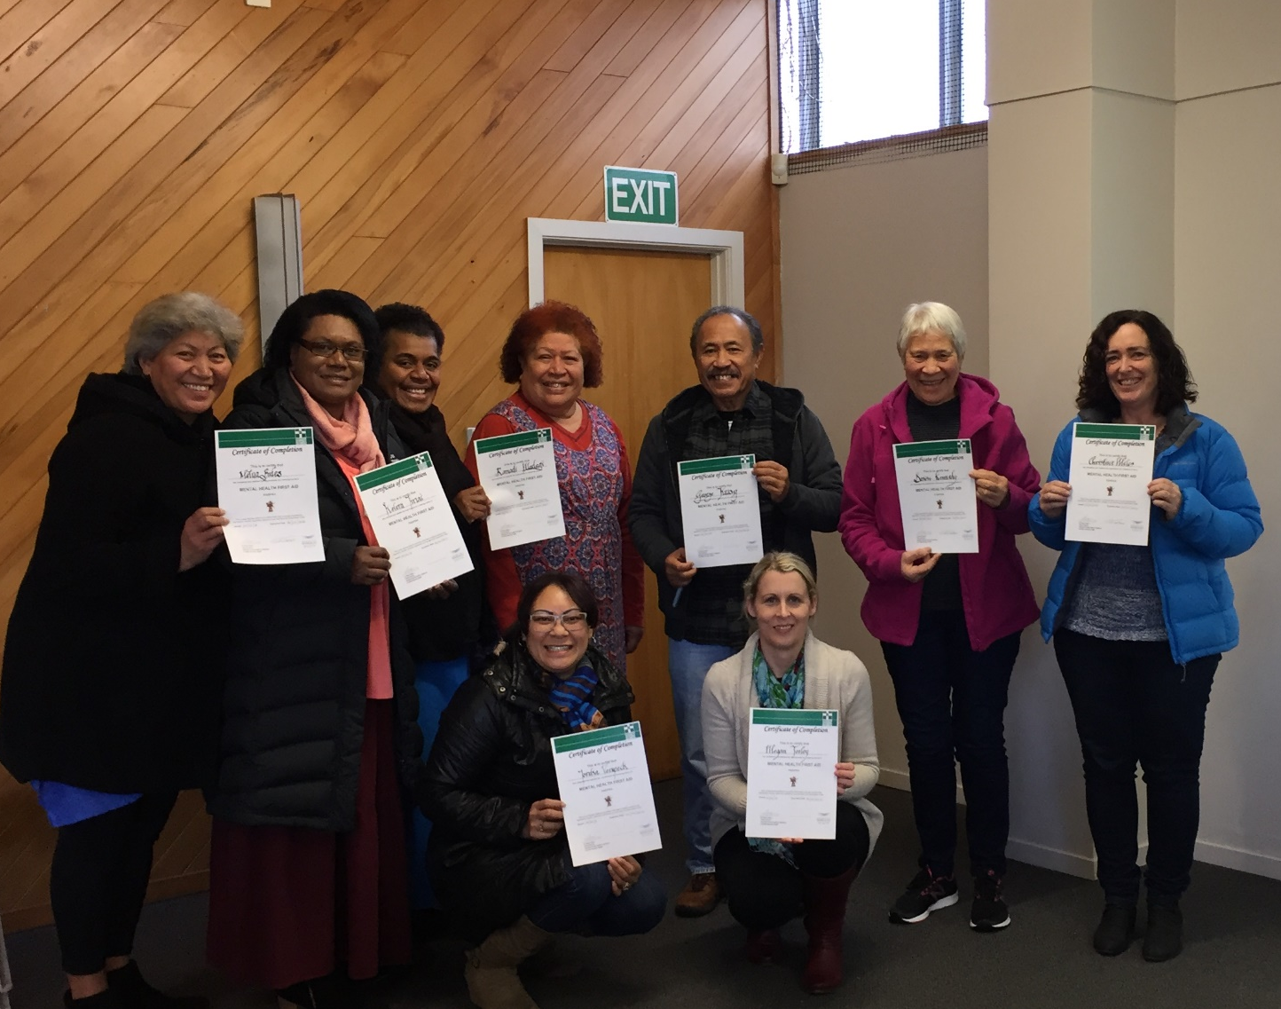


Notes:
This is their community Room.
Training for the church, community

Slide 39
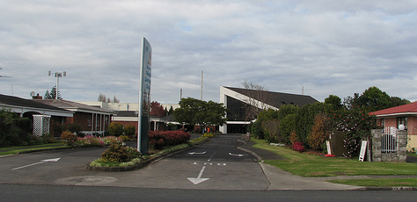
Papatoetoe SDA

Slide 40
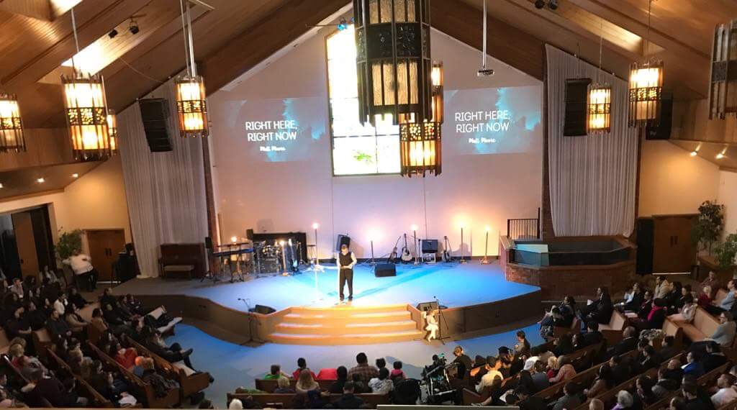

Slide 41
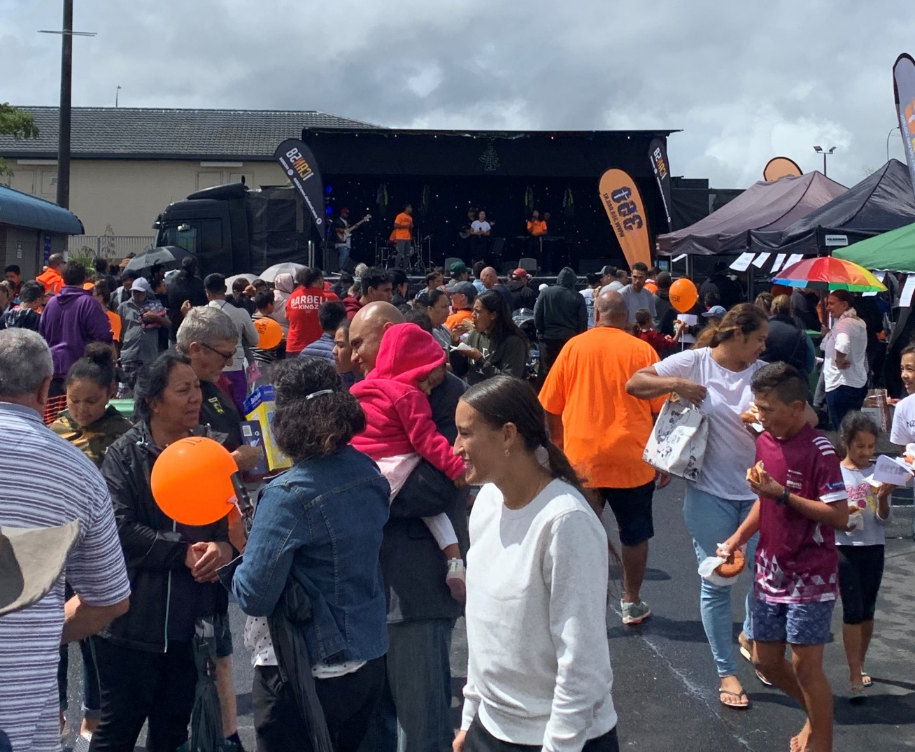
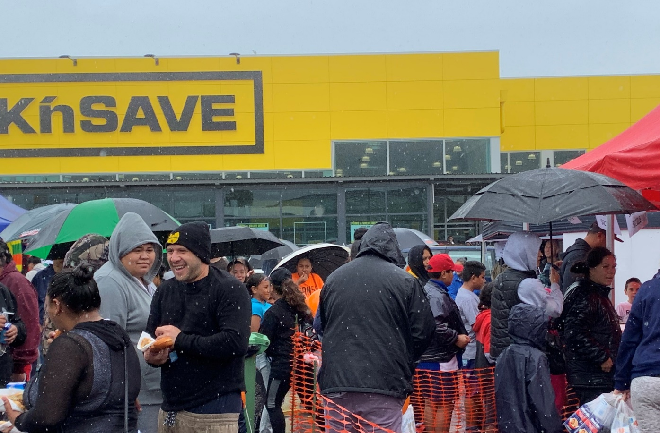
iCAN58 Church Regional

Slide 42
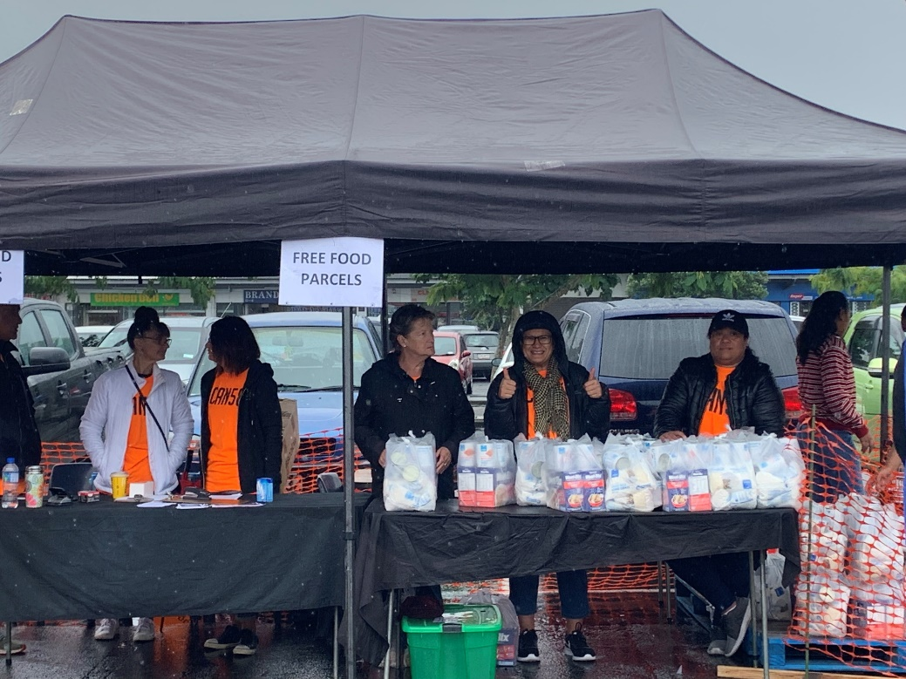
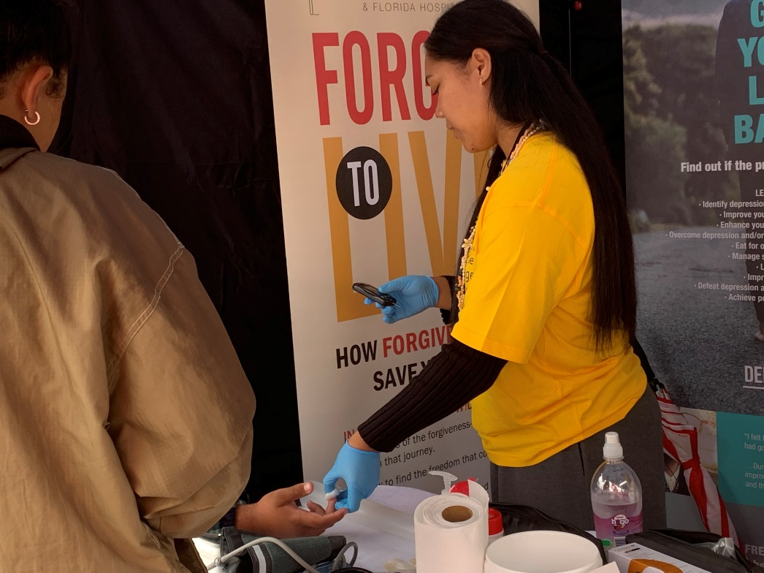
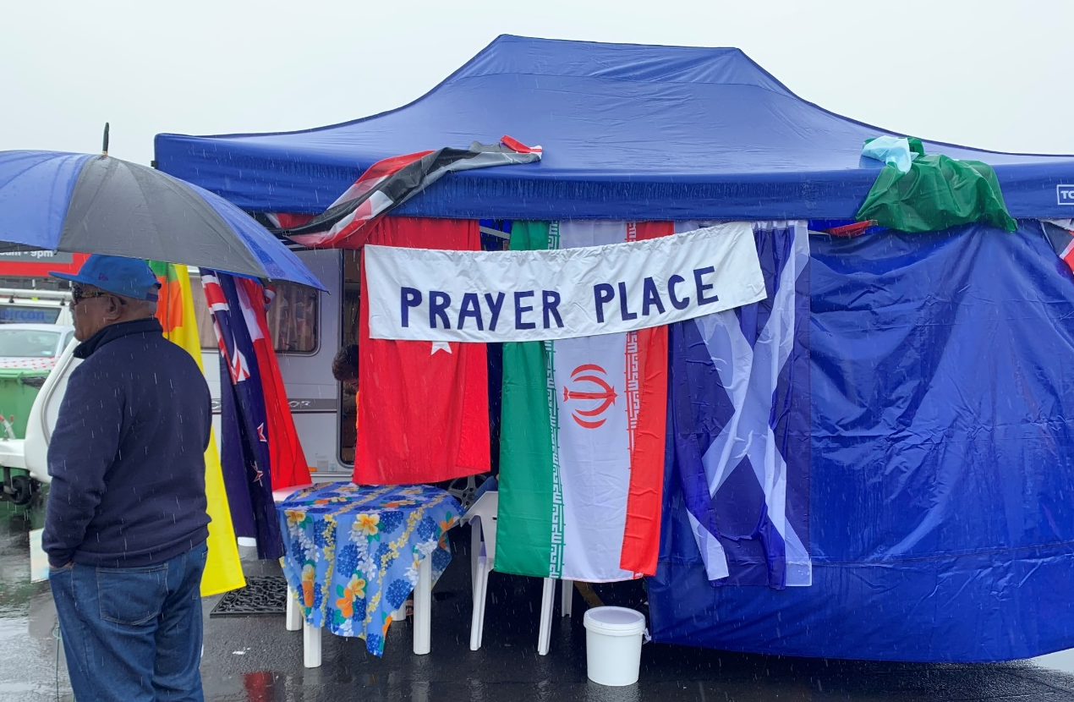

Slide 43



Designing an Initiative
JOB

Slide 44

Marketing
Social Media Tools
Evaluation, monitoring and reporting

Slide 45


Slide 46
More Information?
  ADRA – Sally Lavea
  sallylavea@adra.org.nz or call (09) 625 0883
  Health – Adrielle Carrasco
  AdrielleCarrasco@adventist.org.nz or call (09) 250 2746
  Discipleship – Victor Kulakov
  VictorKulakov@adventist.org.nz or call (09) 250 2733

Slide 47
Wrap up
&
Closing Prayer

